Slide 1
Waldo
Relevant paper
Notes:
Relevant

Slide 2
Gaze following in situations with conflicting gazes.
Only 2 possible locations for Target T L/R)
3 viewing directions: +30, 0, -30
People automatically follow the gaze cue
The gaze cue is strongest when all the gazes share the same orientation

Slide 3
Research Questions:
Original upright experiment
Inverted experiment
Posner paradigm experiment
Stroop effect experiment
Inverted Stroop effect experiment

Slide 5
Waldo
Behavioral Data & Analysis

Slide 6
Original Task
n = 36
Male = 14, Female = 22
B) Not-noticed = 12, Noticed = 24 (notice 100% coherence levels)

Slide 7
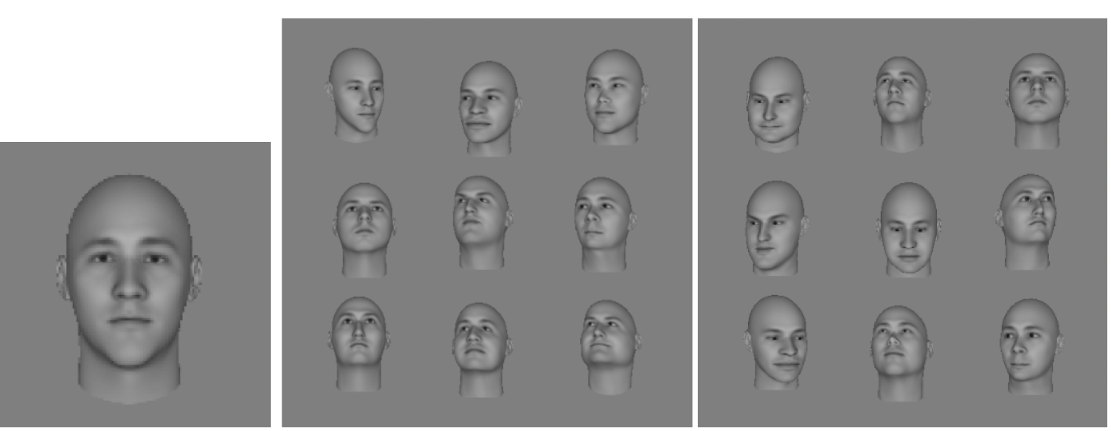
General Design
A.
100%Coherence–8 Distractors
0%Coherence–8 Distractors
Target Face
Participants are instructed to click on the correct face as quickly and as accurately as possible.

Slide 8
Average Reaction Time
Averaged Reaction Time:
Coherence: F(2,70) = 34.16, p<0.001
Distractor: F(1.07, 37.28) = 249.16, p<0.001
Coherence*distractor: F(2.95, 103.09) = 9.89, p<0.001
Main effects of coherence and number of distractors
Interaction between coherence and number of distractors
Notice: F(1, 34) = 0.001, p = 0.98
Notes:
SA; GG; GG

Slide 9
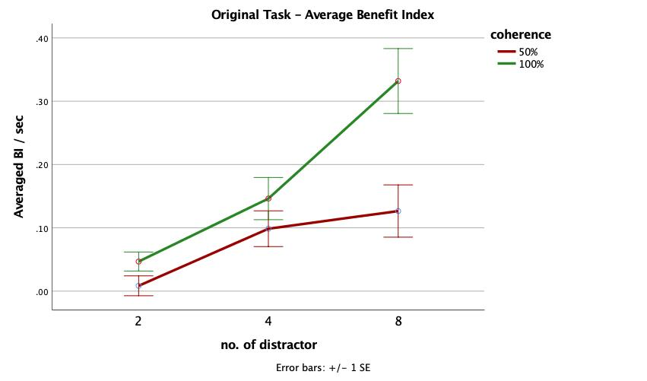
Average Benefit index
Averaged Benefit Index:
Coherence F(1,35) = 18.47, p<0.001
Distractor F(1.65, 57.74) = 13.97, p<0.001
Coherence*distractor F(1.45,50.88) = 6.82, p=0.002
Notice: F(1, 34) = 0.56, p = 0.46
Notes:
GG
HF
GG

Slide 10
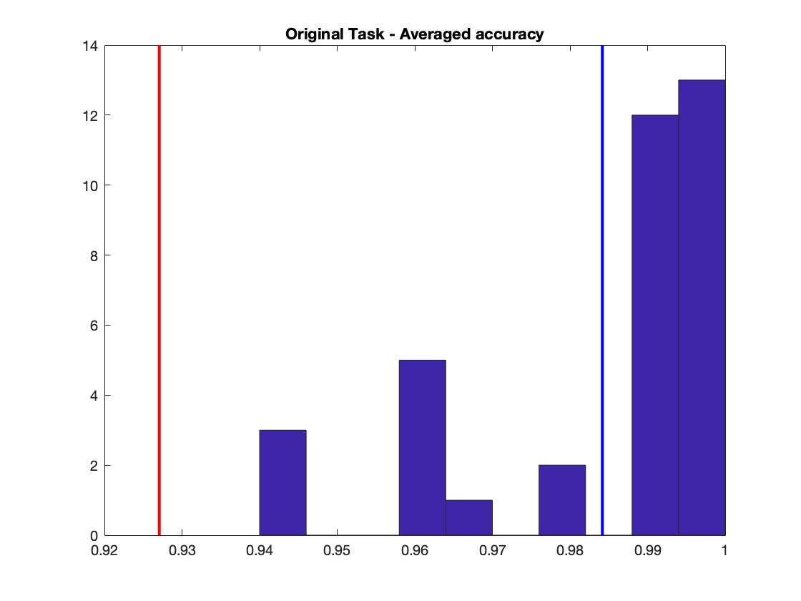
Notes:
OVERALL ACCURADCY HISTOGRAM

Slide 11
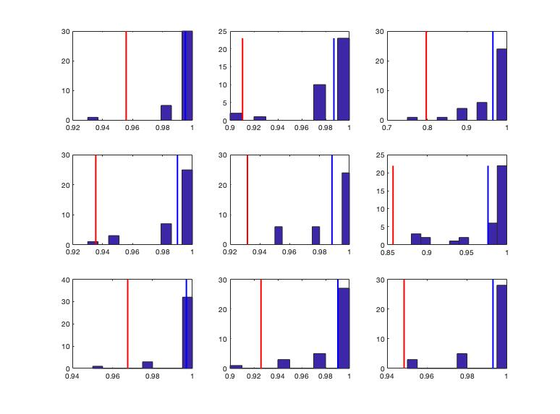
Average Accuracies across conditions
Notes:
ACCURACY HISTOGRAM OVER THE CONDITIONS

Slide 12
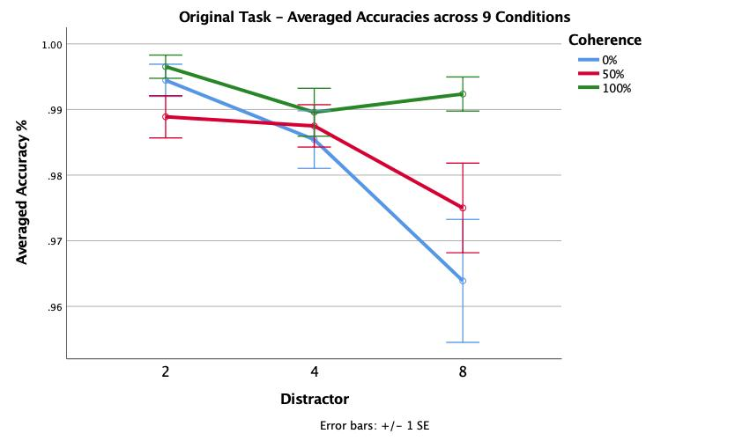
Averaged Accuracies:
Coherence F(2,70) = 8.97, p<0.001
Distractor F(1.68, 58.89) = 8.15, p=0.001
Coherence*distractor F(2.51, 87.92) = 5.30, p=0.004
Notice: F(1, 34) = 0.24, p = 0.63
Notes:
Accuracy plot

Slide 13
Task Performance & AQ
Task performance at 100% coherence:
r34 = -0.026, p=0.88

Slide 14
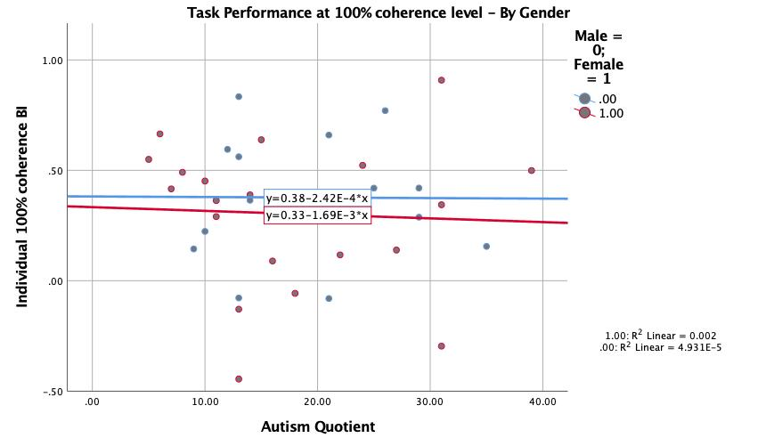
Task performance at 100% coherence:
Male r12 = -0.007, p=0.98
Female r20 = -0.05, p=0.83
Notes:
By gender graph

Slide 15
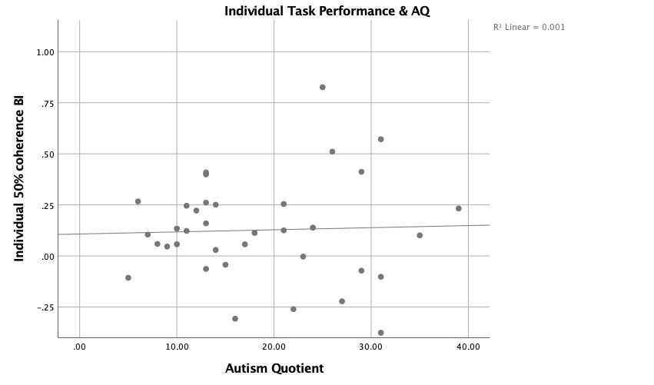
Task performance & AQ
Task performance at 50% coherence:
r34 = 0.037, p=0.83
Notes:
CHANGE the PLOT

Slide 16
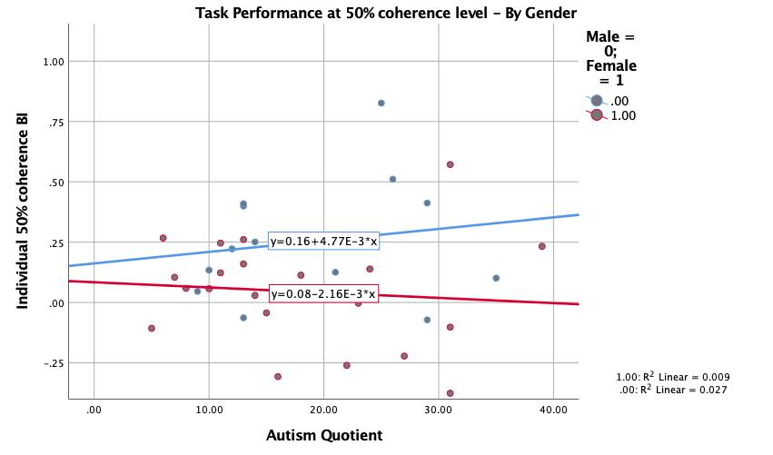
Task performance at 50% coherence:
Male r12 = 0.16, p=0.58
Female r20 = -0.09, p=0.68
Notes:
By gender graph

Slide 17
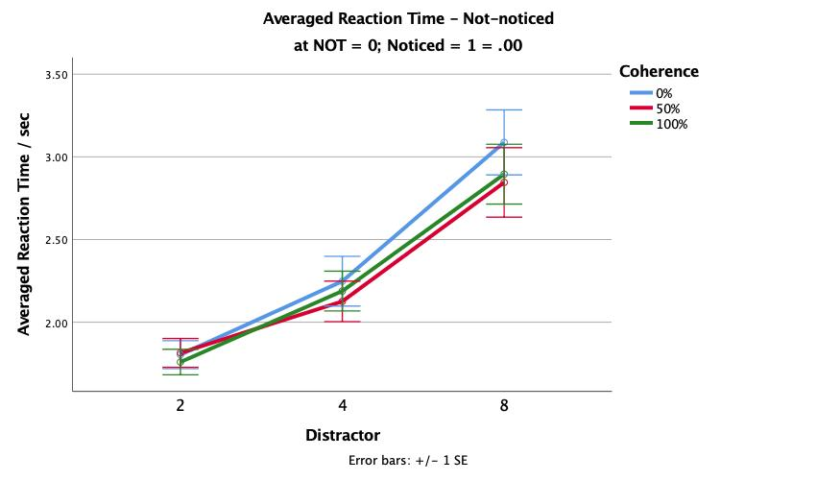
Averaged Reaction Time:
Coherence: F(2,22) = 6.52, p=0.006
Distractor: F(1.02, 11.27) = 102.92, p<0.001
Coherence*distractor: F(4, 44) = 2.51, p = 0.056
Notice: F(1, 34) = 0.001, p = 0.98

Slide 18
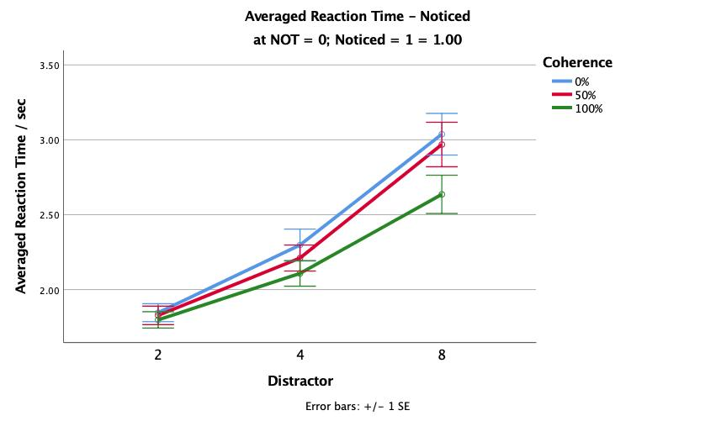
Averaged Reaction Time:
Coherence: F(2,46) = 47.89, p<0.001
Distractor: F(1.07, 24.71) = 146.39, p<0.001
Coherence*distractor: F(2.96, 68.12) = 13.59, p<0.001
Notice: F(1, 34) = 0.001, p = 0.98

Slide 19
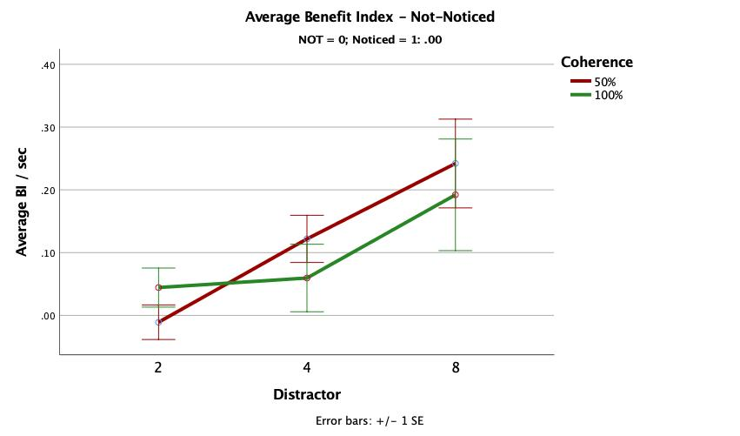
Averaged Benefit Index:
Coherence F(1,11) = 0.26, p = 0.62
Distractor F(2, 22) = 5.46, p = 0.01
Coherence*distractor F(2, 22) = 0.90, p=0.42
Notice: F(1, 34) = 0.56, p = 0.46

Slide 20
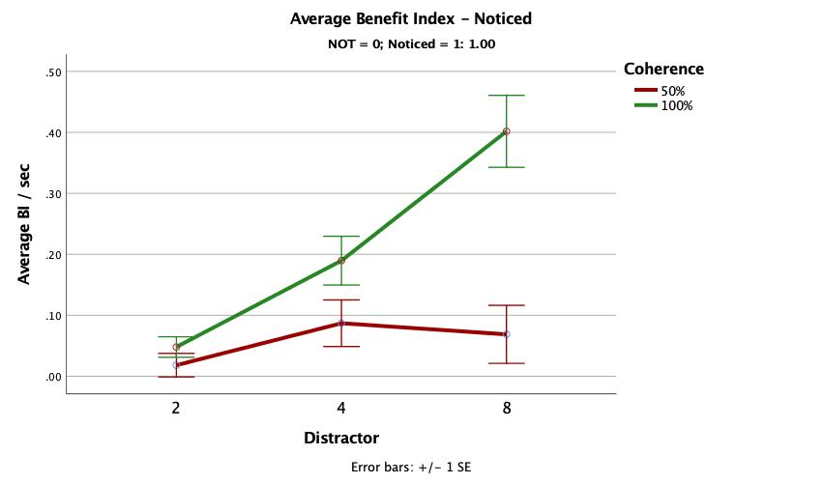
Averaged Benefit Index:
Coherence F(1,23) = 61.62, p<0.001
Distractor F(1.71, 39.31) = 8.47, p = 0.001
Coherence*distractor F(1.47,33.85) = 20.25, p<0.001
Notice: F(1, 34) = 0.56, p = 0.46

Slide 21
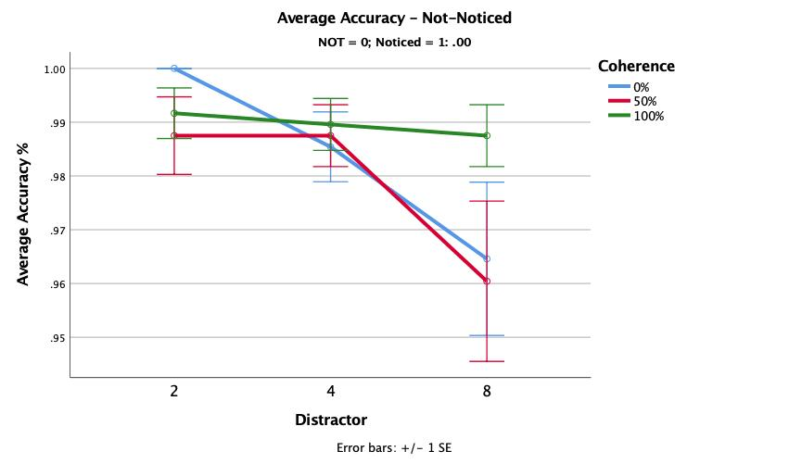
Averaged Accuracies:
Coherence F(2,22) = 3.85, p = 0.037
Distractor F(1.28, 14.02) = 5.35, p=0.03
Coherence*distractor F(1.88, 20.66) = 2.83, p=0.085
Notice: F(1, 34) = 0.24, p = 0.63

Slide 22
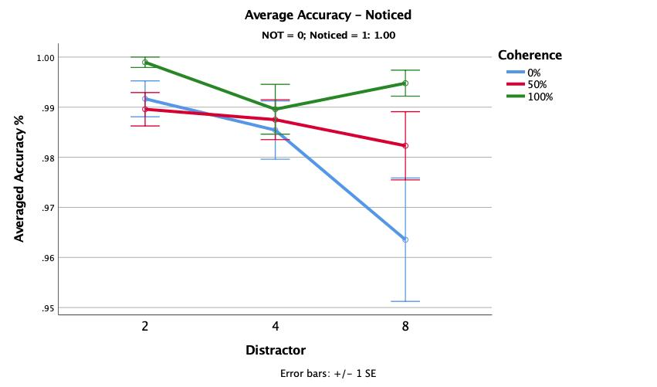
Averaged Accuracies:
Coherence F(1.69, 38.94) = 7.26, p = 0.003
Distractor F(2, 46) = 3.50, p=0.038
Coherence*distractor F(2.02, 46.37) = 3.61, p=0.035
Notice: F(1, 34) = 0.24, p = 0.63

Slide 23
Invert Task
n = 38
a) Not-noticed = 26, Noticed = 12

Slide 24
0%Coherence–8 Distractors
100%Coherence–8 Distractors
Target Face

Slide 25
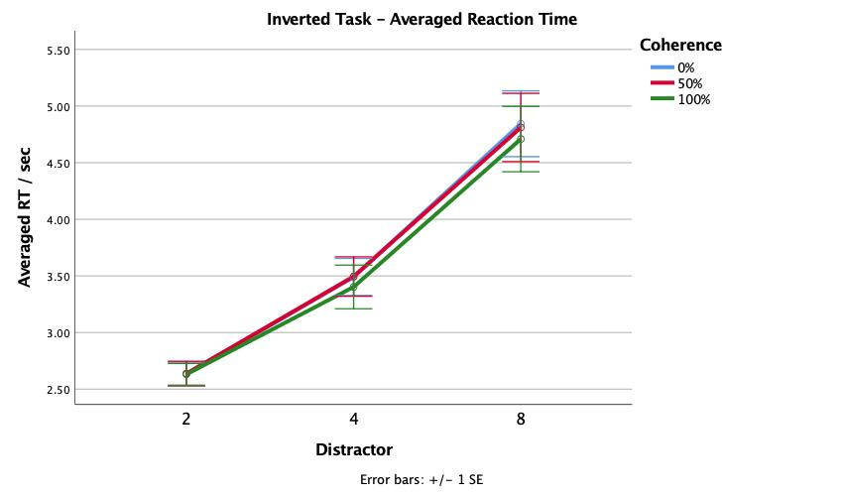
Invert Task Reaction Time
Inverted task RT:
Coherence: F(2, 74) = 1.93, p = 0.15
Distractor: F(1.07, 39.57)= 111.19, p <0.001
Coherence*Distractor: F(2.49, 92.21) = 0.41, p = 0.71
RT & Notice:
Notice: F(1, 36) = 0.44, p = 0.51
No group difference

Slide 26
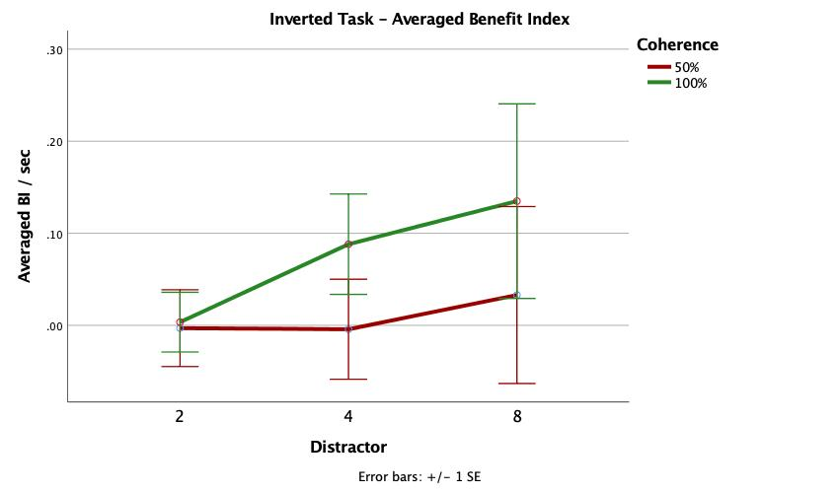
Invert Task Benefit Index
Inverted task BI:
Coherence: F(1, 37) = 1.90, p = 0.18
Distractor: F(1.43, 53.01) = 0.61, p = 0.5
Coherence*Distractor: F(1.49, 55.09) = 0.32, p = 0.67
BI & Notice:
Notice: F(1, 36) = 0.11, p = 0.74
No group difference

Slide 27
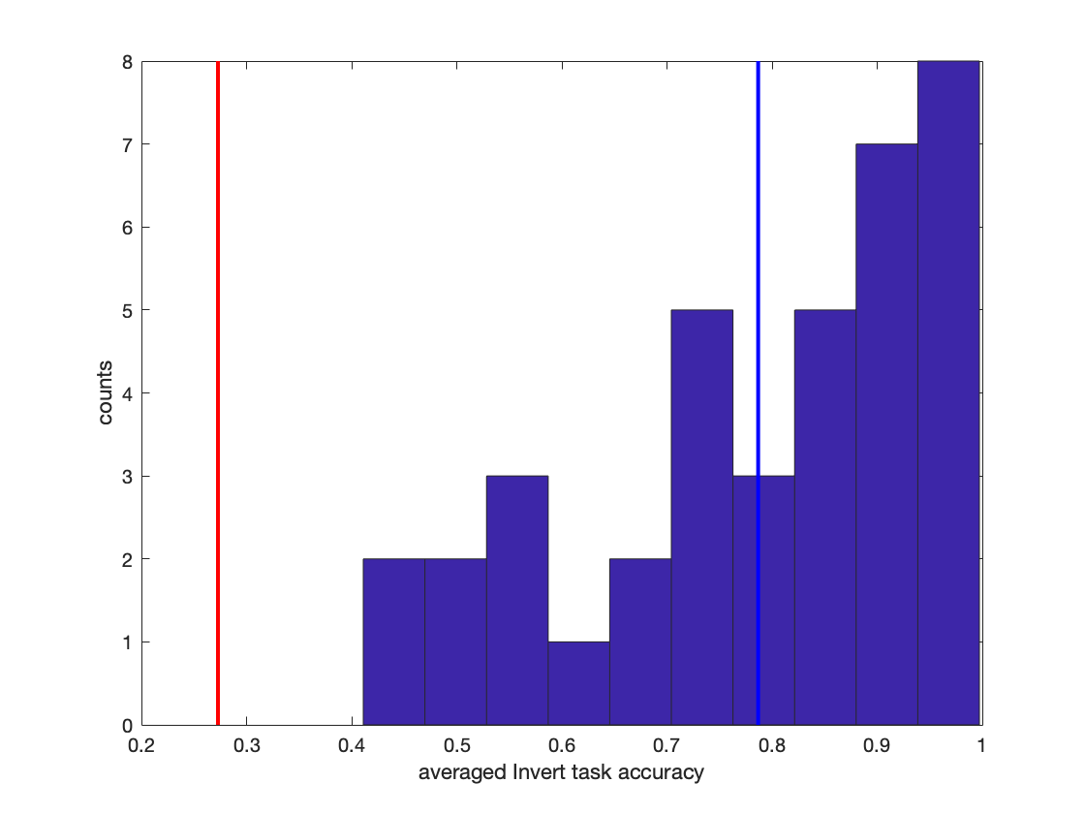
Invert Task accuracy distribution
Invert task average accuracy:
Red line = mean – 3*SD
Blue line = mean

Slide 28
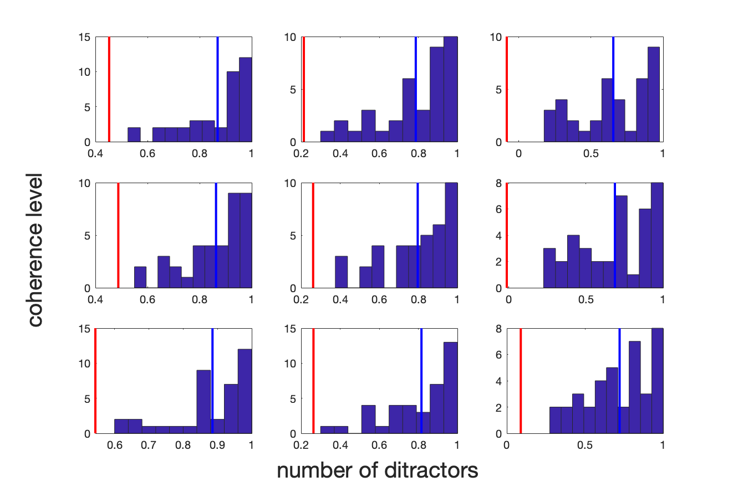
Invert task accuracies distribution:
Red line = mean – 3*SD
Blue line = mean
Top – bottom: increasing coherence
Left – right: increasing no. of distractors

Slide 29
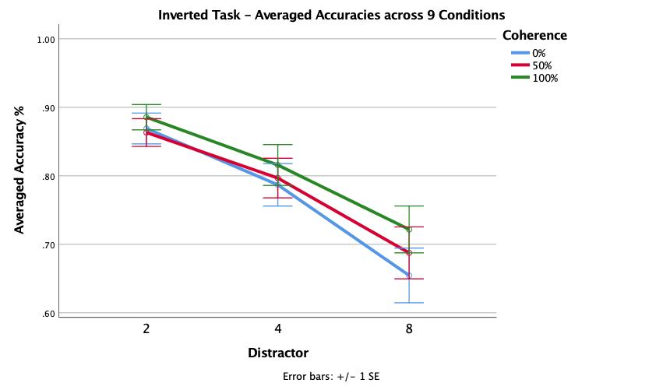
Invert Task accuracies
Inverted Accuracies:
Coherence: F(2, 74) = 9.58, p<0.001
Distractor : F(1.34, 49.62) = 77.64, p<0.001
Coherence*Distractor : F(2.79, 103.10) = 2.45, p = 0.072
Accuracy & Notice:
Notice: F(1,36) = 0.90, p = 0.35
Main effect of coherence and distractor
No interactions, no group differences
Notes:
Coherence * Distractor interaction is significant is sphericity assumed (p=0.049)

Slide 30
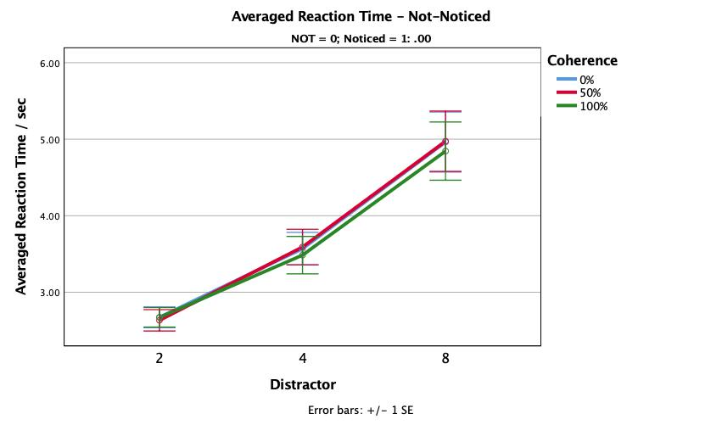
Inverted task RT:
Coherence: F(2, 50) = 1.05, p = 0.36
Distractor: F(1.04, 26.04)= 70.48, p < 0.001
Coherence*Distractor: F(1.97, 49.21) = 0.45, p = 0.64
RT & Notice:
Notice: F(1, 36) = 0.44, p = 0.51
No group difference

Slide 31
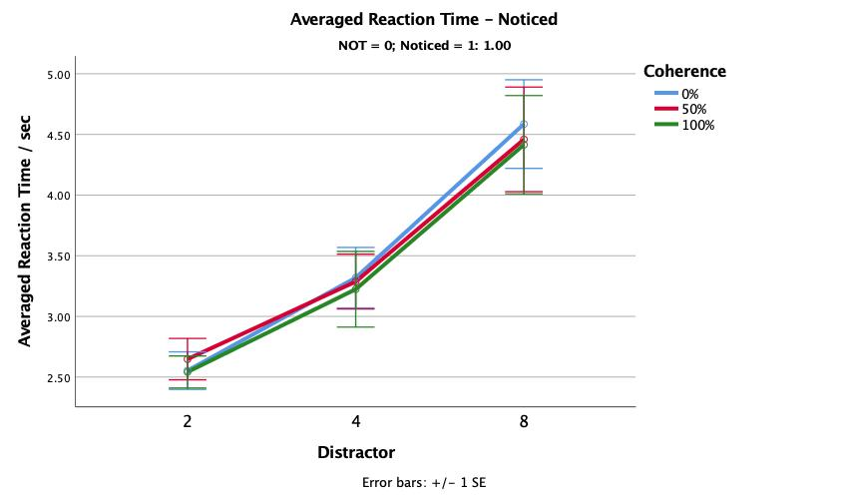
Inverted task RT:
Coherence: F(2, 22) = 0.93, p = 0.41
Distractor: F(1.21, 15.65)= 47.05, p <0.001
Coherence*Distractor: F(4, 44) = 0.35, p = 0.84
RT & Notice:
Notice: F(1, 36) = 0.44, p = 0.51
No group difference

Slide 32
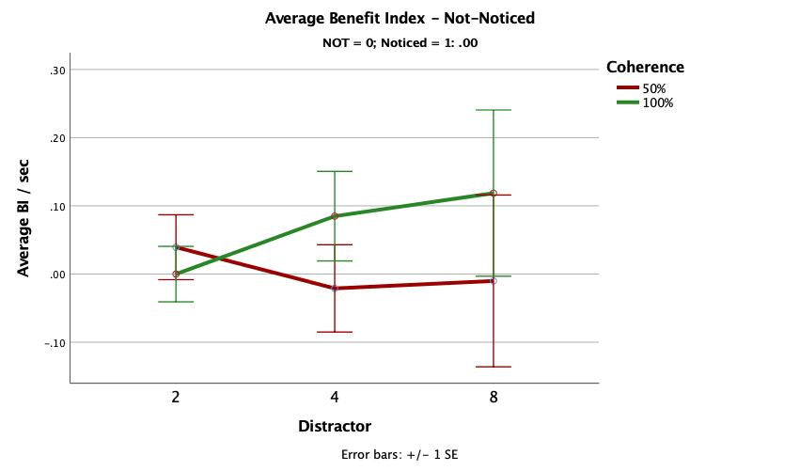
Inverted task BI:
Coherence: F(1, 25) = 1.10, p = 0.30
Distractor: F(1.42, 35.40) = 0.08, p = 0.86
Coherence*Distractor: F(1.24, 31.06) = 0.58, p = 0.49
BI & Notice:
Notice: F(1, 36) = 0.11, p = 0.74
No group difference

Slide 33
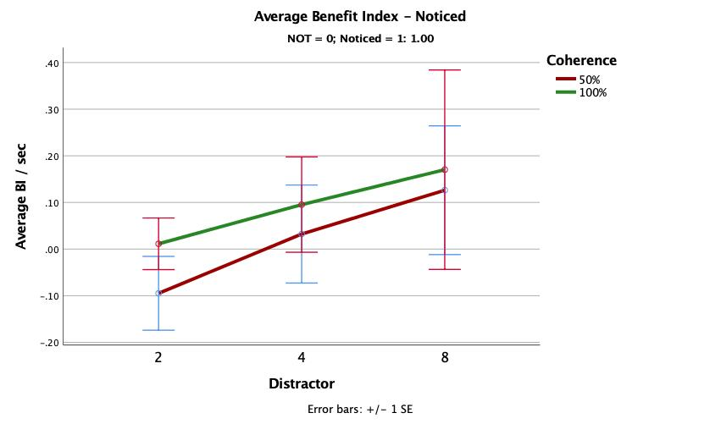
Inverted task BI:
Coherence: F(1, 11) = 0.81, p = 0.39
Distractor: F(2, 22) = 0.74, p = 0.48
Coherence*Distractor: F(2, 22) = 0.05, p = 0.96
BI & Notice:
Notice: F(1, 36) = 0.11, p = 0.74
No group difference

Slide 34
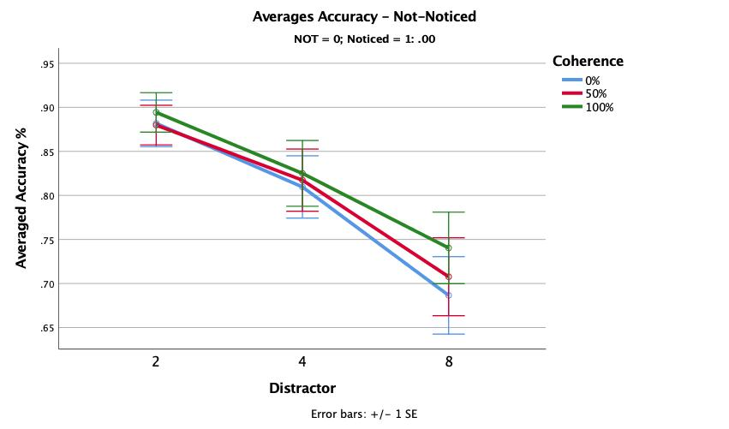
Inverted Accuracies:
Coherence: F(2, 50) = 4.66, p = 0.01
Distractor : F(1.40, 35.01) = 49.69, p<0.001
Coherence*Distractor : F(2.47,61.81) = 1.31, p = 0.28
Accuracy & Notice:
Notice: F(1,36) = 0.90, p = 0.35
Main effect of coherence and distractor
No interactions, no group differences

Slide 35
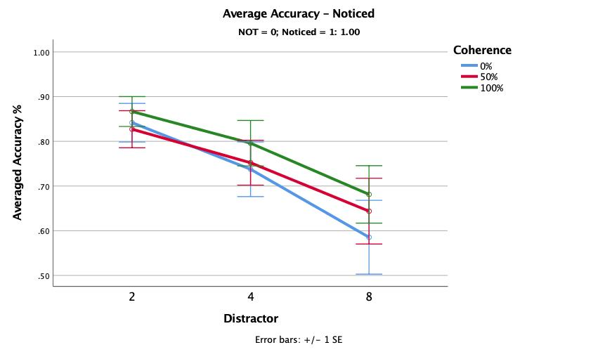
Inverted Accuracies:
Coherence: F(2, 22) = 5.00, p<0.02
Distractor : F(1.22, 13.44) = 26.91, p<0.001
Coherence*Distractor : F(2.55, 28.04) = 1.49, p = 0.24
Accuracy & Notice:
Notice: F(1,36) = 0.90, p = 0.35
Main effect of coherence and distractor
No interactions, no group differences

Slide 36
Posner Task
n = 38 (one outlier based on Accuracy)
a) Not-noticed = 29, Noticed = 9

Slide 37
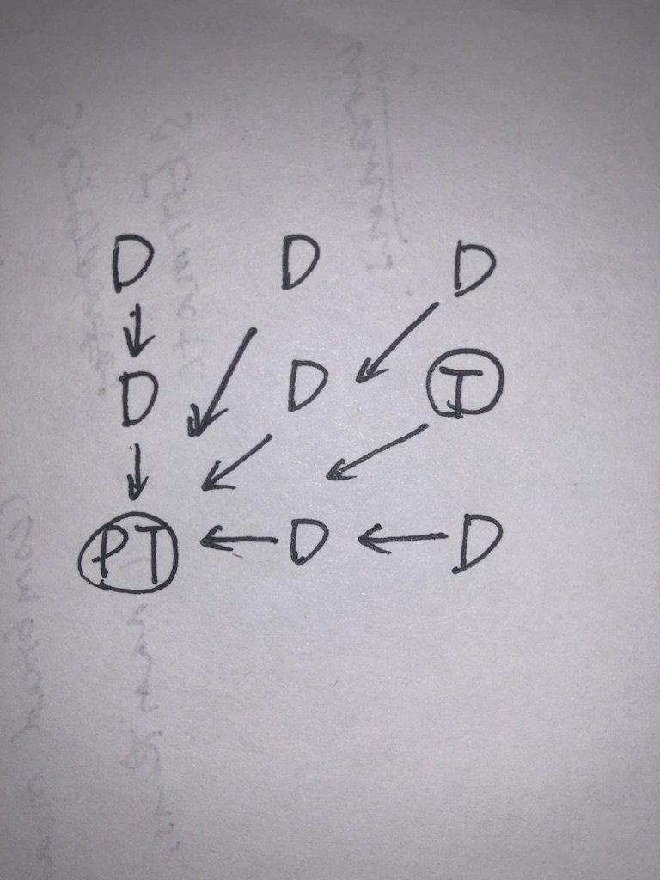
Posner task design:
Invalid condition: Always 8 distractor = 1 pseudo-target + 7 distractors.
7 D + T are looking towards the PT
Valid condition: all 8 distractors are looking towards the real target
Neutral/baseline = 0% coherence with 8 distractors

Slide 38
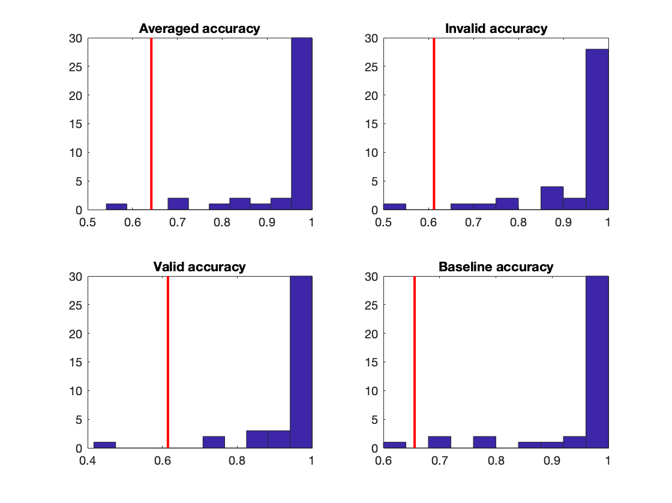
Posner task accuracies:
Redline = mean – 3*SD
the participant who is consistently on the left of the line is the potential outlier (P21)

Slide 39
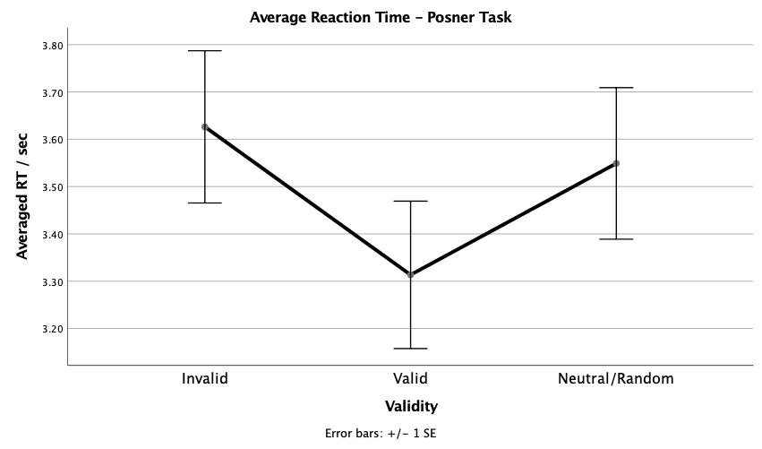
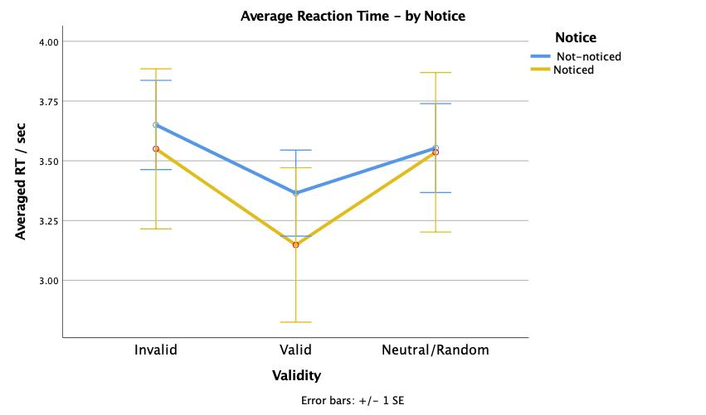
Posner Reaction Time
Posner task RT:
Validity: F(1.83, 66.02) = 6.40, p = 0.003
Validity*Notice: F(1.83, 66,02) = 0.47, p = 0.63
Notice: F(1, 36) = 0.1, p = 0.758
Posner task – by Noticed:
Not-Noticed:
Validity: F(2, 56) = 4.72, p = 0.01
Noticed:
Validity: F(1.21, 9.67) = 2.29, p = 0.16

Slide 40
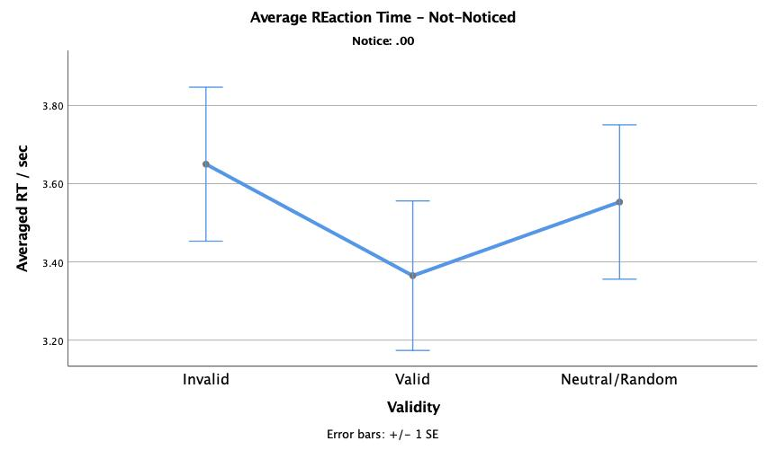
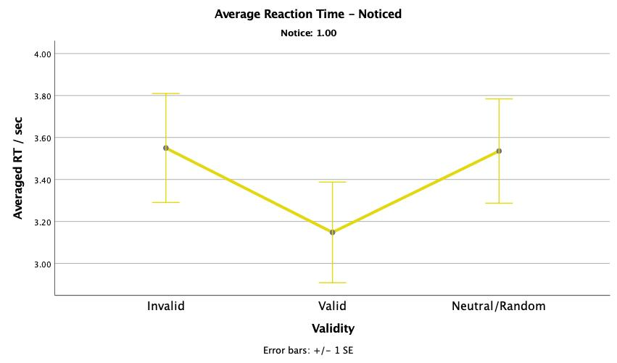

Slide 41
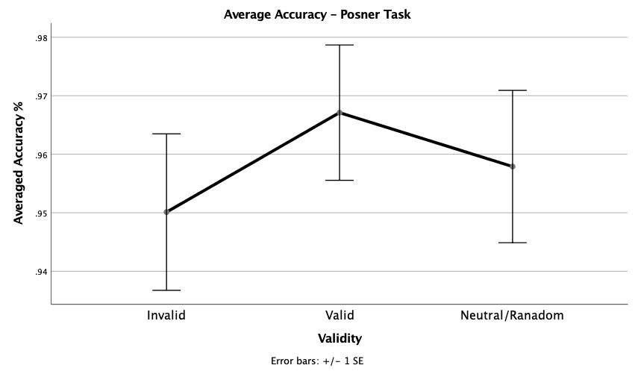
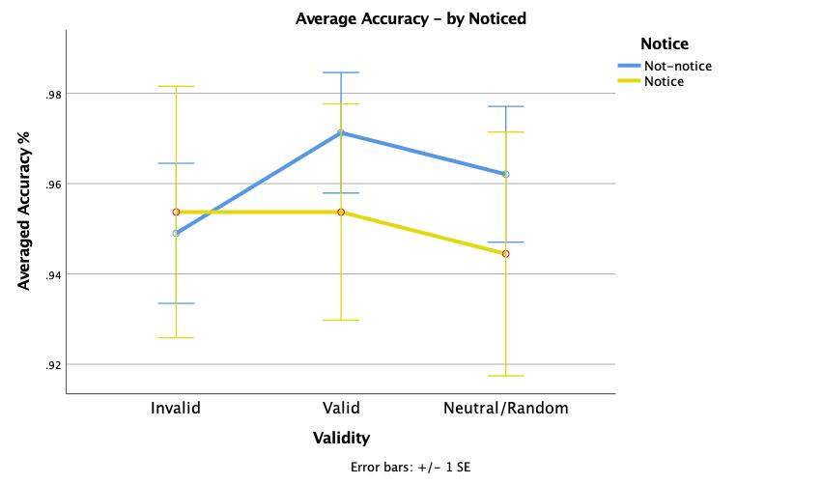
Posner Reaction Accuracy
Posner task accuracy:
Validity: F(1.63, 55.17) = 0.91, p = 0.41
Validity*Notice: F(1.63, 55.17) = 1.07, p = 0.34
Notice: F(1, 36) = 0.13, p = 0.72
Posner task – by Noticed:
Not-Noticed:
Validity: F(1.36, 38.15) = 3.00, p = 0.08
Noticed:
Validity: F(2.00, 15.94) = 0.46, p = 0.52cc

Slide 42
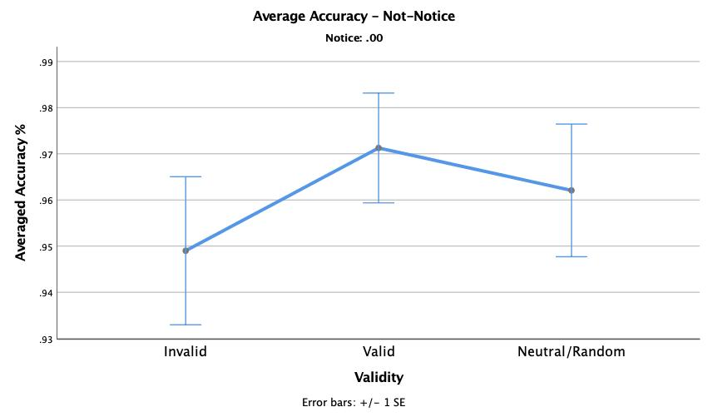
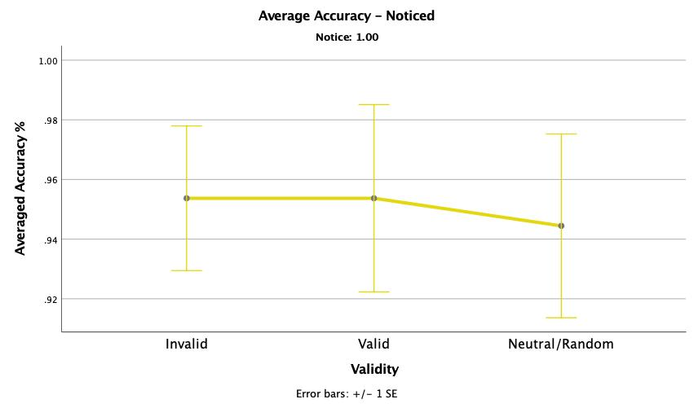

Slide 43
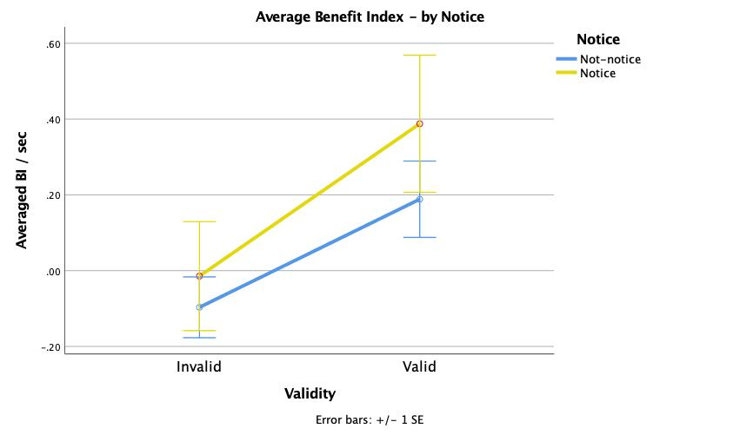
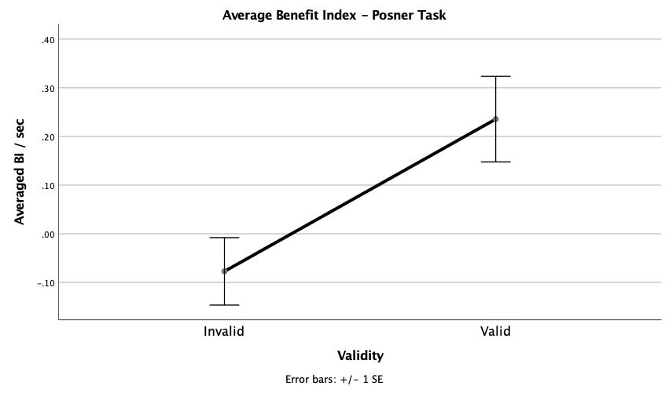
Posner Benefit Index
Posner task BI:
Validity: F(1, 36) = 8.20, p = 0.01
Validity*Notice: F(1, 36) = 0.24, p = 0.63
Notice: F(, 36) = 0.96, P = 0.33
Invalid: t37 = -1.12, p = 0.24
Valid: t37 = 2.68, p = 0.01
Posner task – by Noticed:
Not-Noticed:
Validity: F(1, 28) = 7.49, p = 0.01
Noticed:
Validity: F(1, 8) = .147, p = 0.18

Slide 44
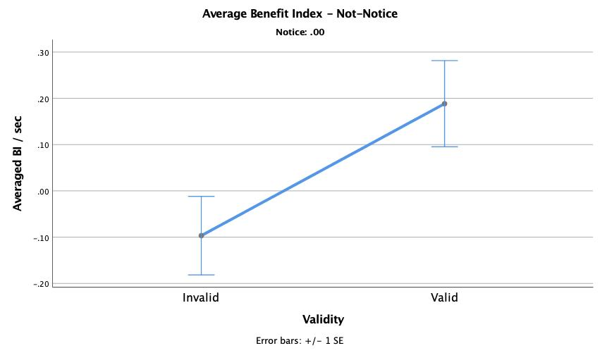
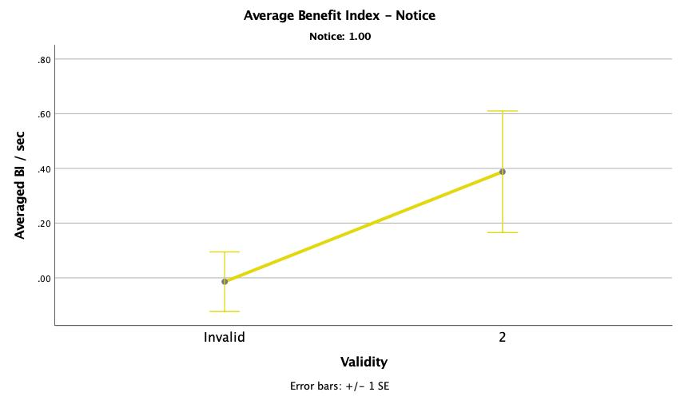
Posner task BI t-test:
Invalid: t28 = -1.14, p = 0.13
Valid: t28 = 2.02 , p = 0.03
Posner task BI t-test:
Invalid: t8 = -0.13, p = 0.45
Valid: t8 = 1.74, p = 0.06

Slide 45
Stroop Effect Task
n = 9

Slide 46

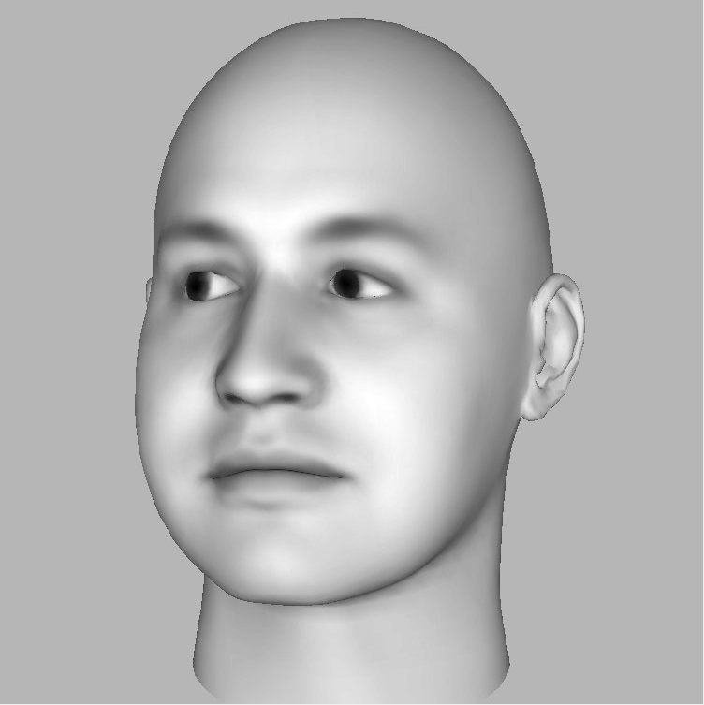
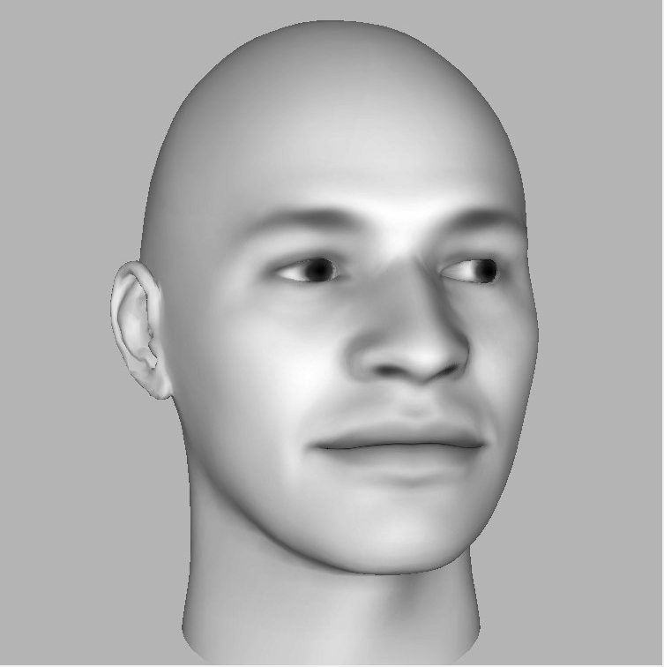
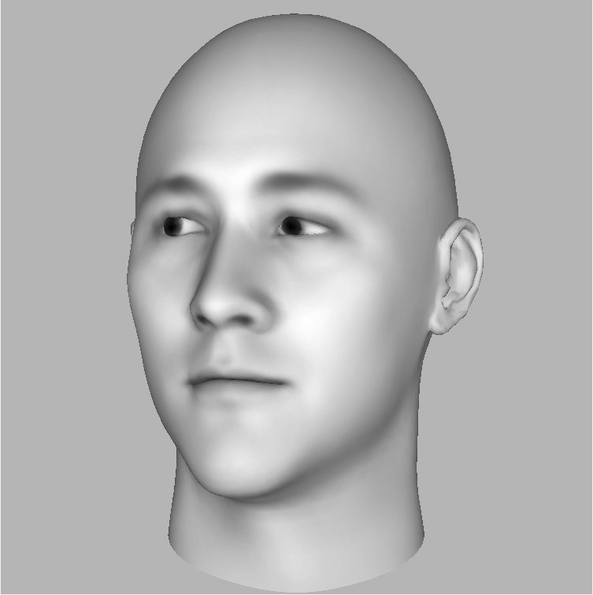
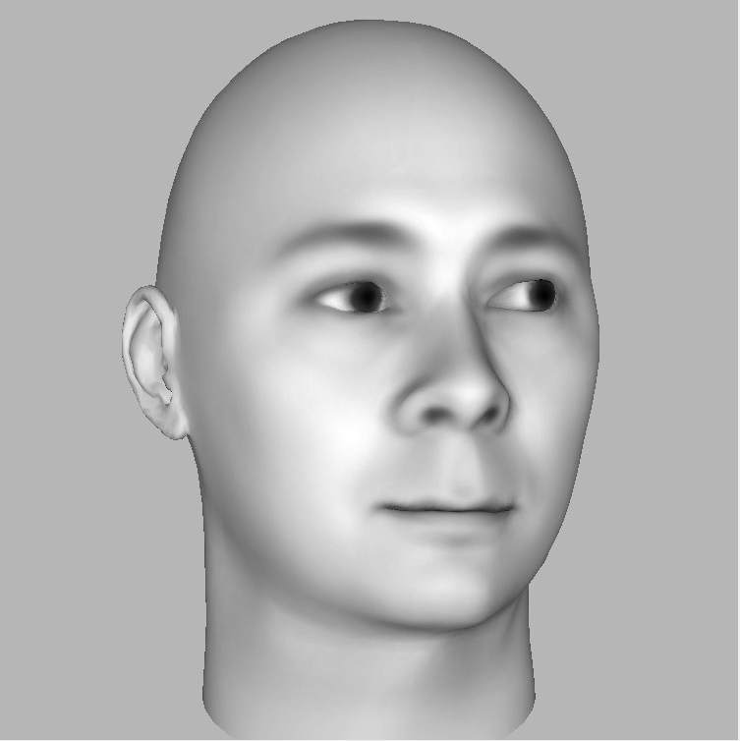
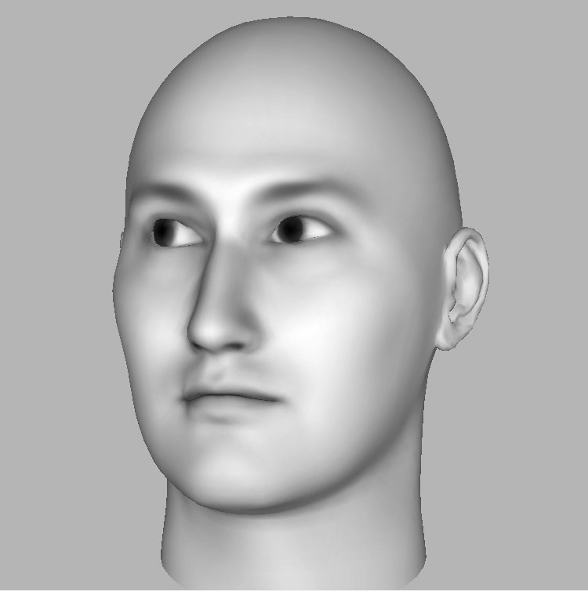
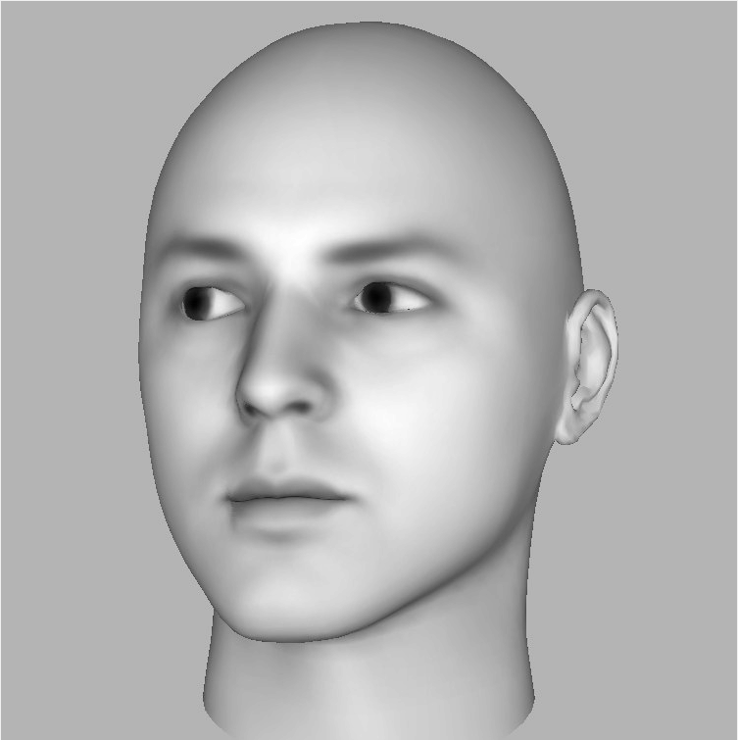
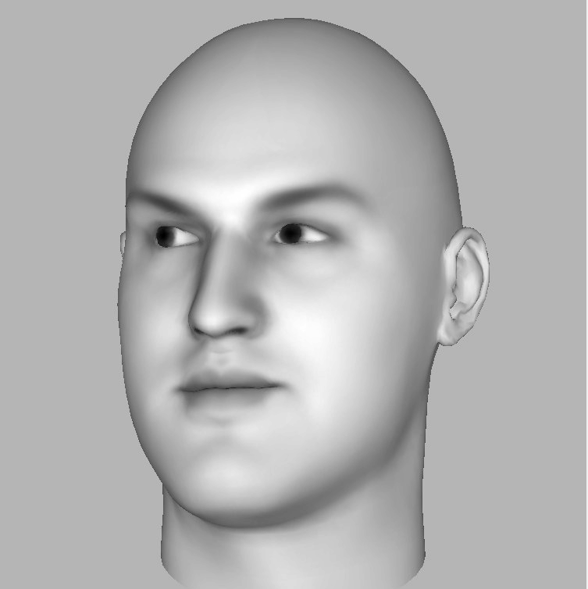
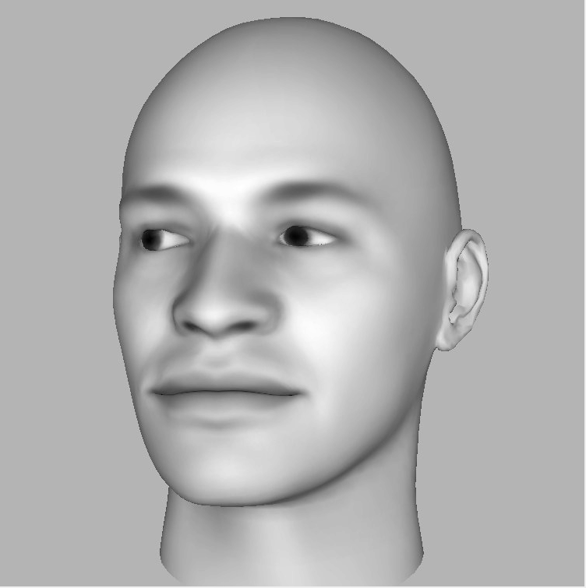
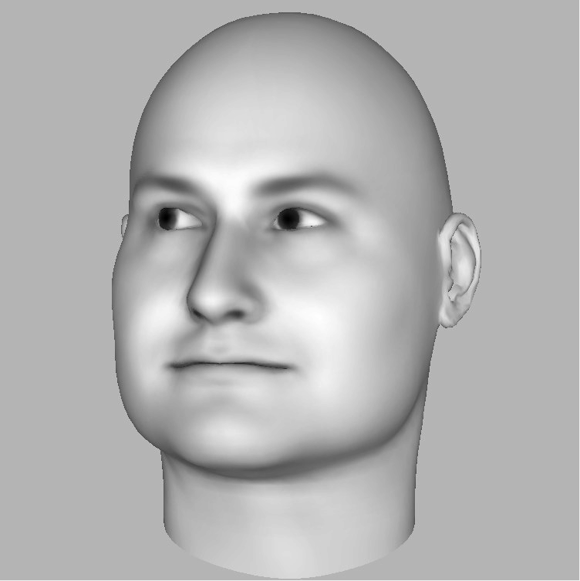
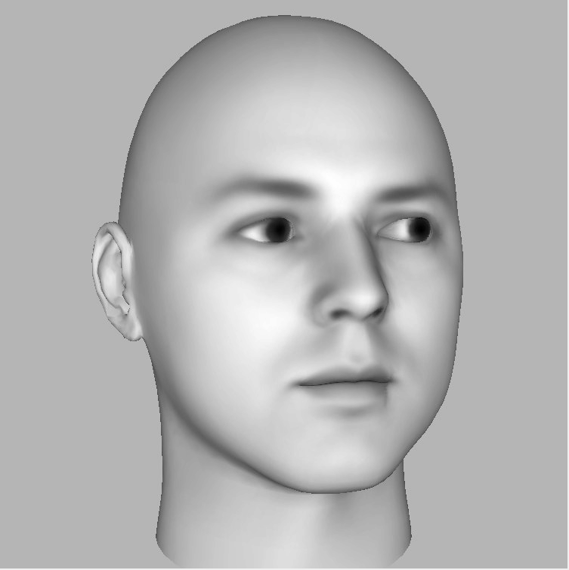
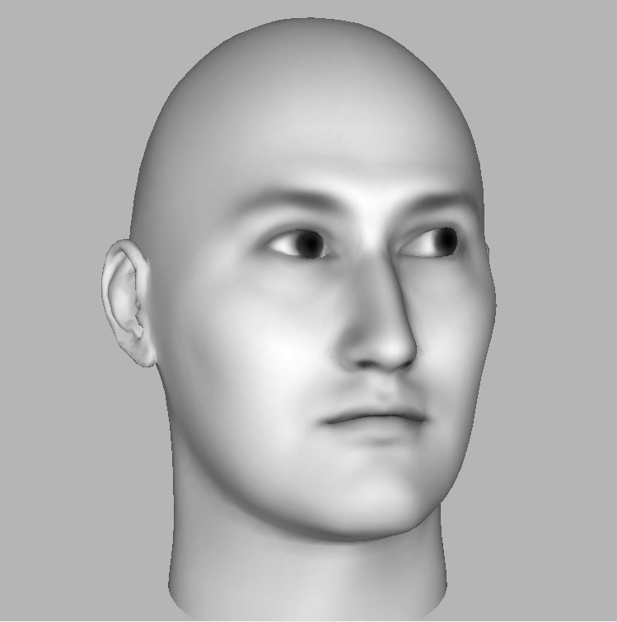







Congruent
Incongruent

Slide 47

Baseline/Front-view

Slide 48


Slide 49


Stroop effect task RT:
Congruence: F(2, 16) = 9.34, p = 0.002
Stroop effect task Accuracy:
Congruence: F(2, 16) = 3.74, p < 0.05

Slide 50

Stroop task BI:
Congruence: F(1, 8) = 10.64, p = 0.01
Incongruent: t8 = -3.12, p = 0.01
Congruent: t8 = 2.17, p = 0.03

Slide 51


Slide 52
Inverted-Stroop Effect Task
n = 7

Slide 53


Slide 54


Inverted-Stroop effect task RT:
Congruence: F(2, 12) = 10.23, p = 0.003
Inverted-Stroop effect task Accuracy:
Congruence: F(2, 12) = 6.18, p = 0.01

Slide 55

Stroop task BI:
Congruence: F(1, 6) = 11.82, p = 0.01
Incongruent: t6 = -5.47, p < 0.01
Congruent: t6 = 1.47, p = 0.1

Slide 56


Slide 57
Example Eye-movement Traces
- For 1) Original, 2) Inverted, 3) Posner paradigm experiments

Slide 59
Future direction (& work need to do):
Eye movement data

Slide 62

Power analysis:
Partial eta squared = 0.06
Effect size f = 0.253
Power = 0.8
Alpha = 0.05
Number of groups =

